Slide 1
THz generation Yamanouchi laboratory
2018/06/29

Slide 2
Outline
Applications
Experiment purpose
EO sampling
Mechanism of optical rectification
Optical setup
Data
Conclusion

Slide 3
Purpose of work
Generation of THz radiation
Electro optical sampling
Measurement of THz power

Slide 4
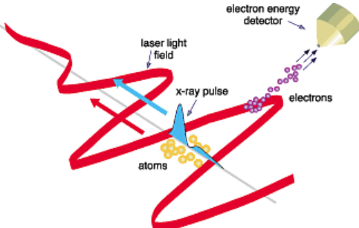
TAES
THz-assisted electron diffraction
Electron streaking
Finish it!
DOI: 10.1117/2.5200405.0005

Slide 5
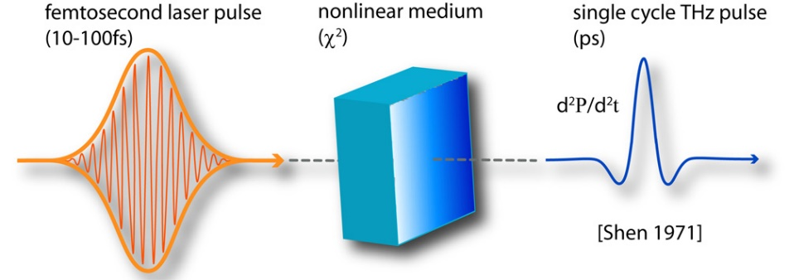
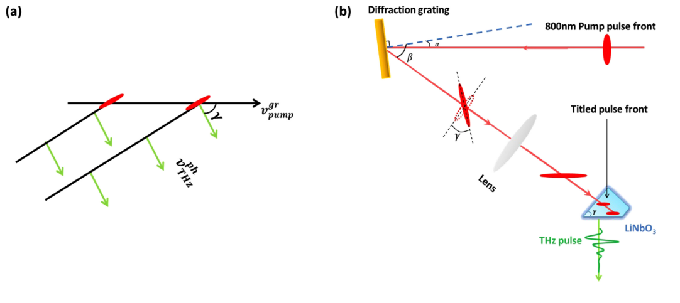
THz generation
Optical rectification
In the far field
Velocity phase matching：
[1] http://qcmd.mpsd.mpg.de/index.php/Broadband-Time-resolved-terahertz-spectroscopy.html
[2] H A Hafez et al 2016 J. Opt. 18 093004

Slide 6
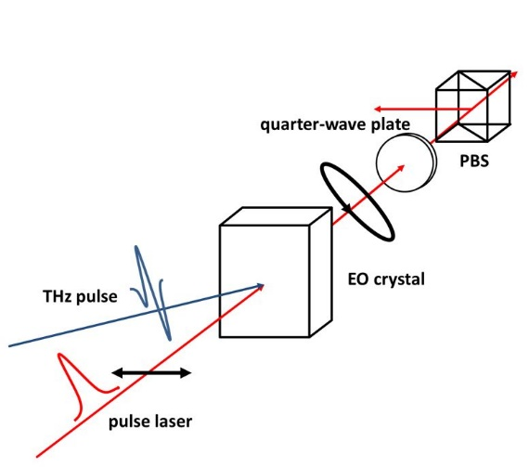
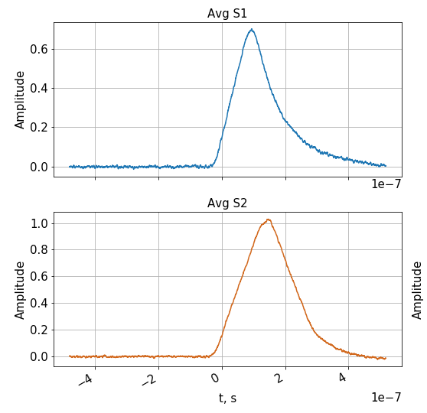
EO sampling
Oscilloscope measurements
Bad result of
THz measurement
*http://www.f.waseda.jp/washiom/research_eo.html
From the following equation
#Check again these calculations
E_{THz} can be evaluated as 0.93063 kV/cm
#What is expected value!?!
Alleged reason for this outcome is badly focused and collimated THz beam

Slide 7
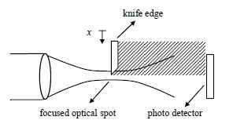


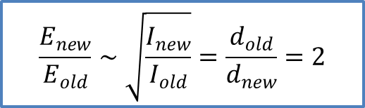
Diffraction limit
Scanning knife edge → THz beam size
→ more accurate collimation and focusing
( Yi Chiu et al., Opt. Express 15, 6367-6373 (2007))
Analysis of the
result
The THz beam expansion was necessary to focus beam on the smallest spot
and the new parabolic mirror was bought for that purpose
Estimated THz field increase:
$$\frac{E_{new}}{E_{old}}∼\sqrt{\frac{I_{new}}{I_{old}}}=\frac{d_{old}}{d_{new}}=2$$

Slide 8
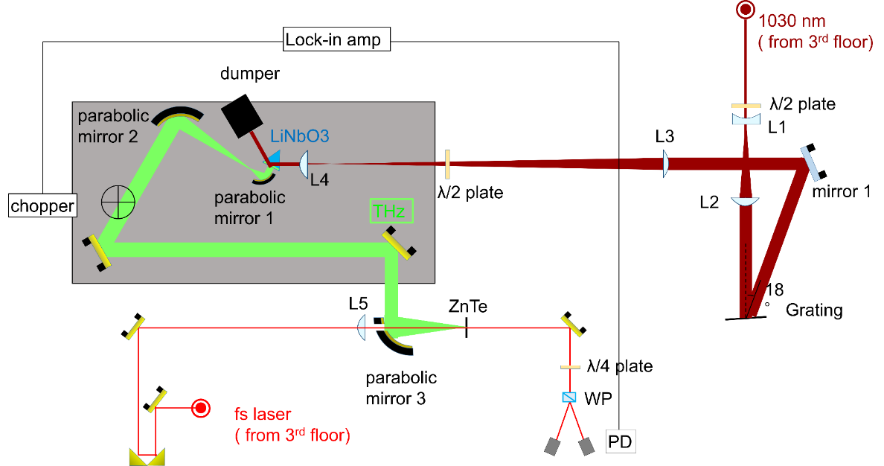
Optical setup
Yb laser parameters:
λ = 1030 nm
P_{pulse} = 6 W – 20 W
Electric field?
Δτ ＝ 1.2 ps
Rep. rate ＝ 100 kHz
THz beam properties:
Previous setup THz beam size ~ 10 mm
Current setup THz beam size ~ 20 mm
Power efficiency ~ 10⁻⁴
The parabolic mirror (show which) was changed to increase THz beam size and get higher
resolution according to the expression
To introduce THz radiation to the chamber, the optical path (show which) should be
prolonged and this procedure was implemented

Slide 9
Conclusion
THz radiation has been generated
EO sampling results showed inappropriate THz beam properties
THz setup has been changed to get higher diffraction limit
Measurement of THz radiation power has been performed

Slide 10
THz detection EO sampling
Intensity difference without THz
Intensity ratio with THz

